Slide 1
Power management and Energy consumption in smart things Professor: Dr.Mahdi Rasti Lecturer: HamidReza Hemati AmirKabir University of Technology Fall 2021

Slide 2
Agenda
1- Big concept
2- Things
3- Power management
4- software technics to reduce power consumption
5- Hardware
approaches to reduce power consumption
6- Important pins
IoT definition
IoT architecture
Technical research challenges
Defination of Things
sensors
Actuators
Communication technologies and devices
Power supllies in Iot
Power consumption
Battery capacity
Different kind of batteries
Importance of power management
esp8266
Arduino boards
Designing Personalized Boards
Removing extra parts
Working Voltage and clock speed
Analog to Digital converter
pulse width modulation

Slide 3
BIG CONCEPT
1
Let’s start with big concept about "Internet of Thing" and “Power Management"

Slide 4
Introduction
The Internet of Things (IoT) is an extension of the Internet in which large numbers of “things”, including sensors, actuators and processors, in addition to human users, are networked and able to provide high resolution data on their environment and exercise a degree of control over it[1].
The principal advantage of IoT consists of its ability to enable communication between an infinite amount of machines incorporated into a large-scale wireless network[1].
These automated devices and sensors together produce and transmit information in real-time, which is useless in the case of incorrect or insufficient filtering and data processing[1].

Slide 5

Introduction
Cloud Server
IoT Edge Device
IoT Sensor
IoT Gateway/
Framework
Stream Processing
User
Interface
Bulk Device Provisioning
etc.,
Data Transformation
Reporting
Tools
Machine
Learning
User
Management
Things
Insights
Action
Figure 1: Abstract architectures[2].

Slide 6
The main IoT technical research challenges
Design
Architecture
Interoperability
Scalability
Mobility
Security and Privacy
Scientific/Engineering
Energy efficiency/Power
Reliability /Robustness
Management/ Operation
Software
Development
Availability
Data management
Cloud computing
[1] Peter J. Ryan 1 and Richard B. Watson, “Research Challenges for the Internet of Things: What Role Can OR Play?”, systems journal, 14 March 2017 .

Slide 7
Introduction
Many of these challenges are technical, including interoperability and scalability
Reducing power consumption and increasing battery life is one of the most important challenges especially in LP applications
How to invest in the IoT is a challenge for business
Major social, legal and ethical challenges, including security and privacy
As the future IoT will be a multi-national, multi-industry, multi-technology infrastructure

Slide 8
Things
2

Slide 9
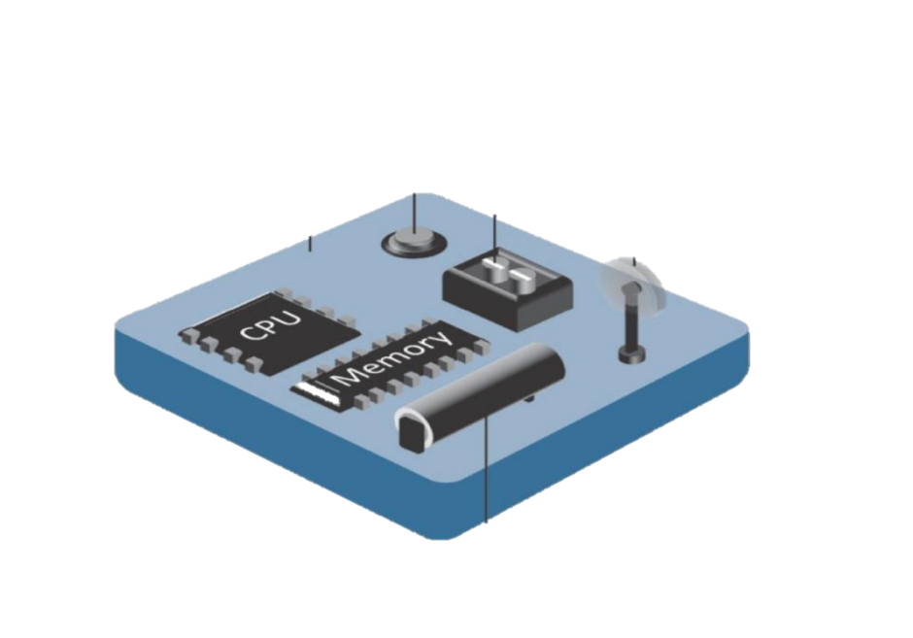
What are things?
Sensor
That can measure physical data
Actuator
Capable of performing a task
A thing, in the context of the Internet of things, is an entity or physical object that has a unique identifier, an embedded system and the ability to transfer data over a network.
A smart object has at a minimum, the following four defining characteristics
Processing unit
Sensor(s) and/or Actuator(s)
Communication Device
Power Source
Tiny low cost Computer
Embedded into objects to make them smart
Can be organized into networks
Communication Device
Receives instructions,
send or routes data
Figure 2: smart thing[2]
Power Source
Scavenger (solar/wind), battery
[2] IoT Fundamentals: Networking Technologies, Protocols, and Use Cases for the Internet of Thing, Cisco press, 2017

Slide 10
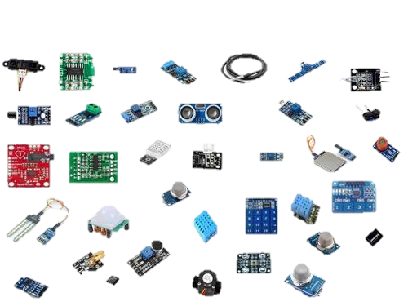
Sensors
Measures some physical quantity and converts it into a digital representation (ADC in section 7).
Each sensor consumes different power depending on its type or application
Figure 3: different sensors
[2] IoT Fundamentals: Networking Technologies, Protocols, and Use Cases for the Internet of Thing, Cisco press, 2017

Slide 11
Actuators
Actuators receive some type of control signal (commonly an electric signal or digital command, PWM in section 7) that triggers a physical effect, usually some type of motion, force, voice, light and so on.
Like sensors each kind of actuator consume different amount of power. For example motor power consumptions is much higher than buzzer
[2] IoT Fundamentals: Networking Technologies, Protocols, and Use Cases for the Internet of Thing, Cisco press, 2017

Slide 12
Communication technologies
An essential requirement for implementing a large and cooperating network of devices is the ability to have a flexible, inexpensive and adaptive connectivity layer
For these reasons, during the years, several wireless connectivity standards have emerged, ranging from very short-range, low power connections to long range connectivity solutions based on cellular technologies.
While short-range protocols can be successfully used for a number of applications (e.g., smart homes, wearable, etc.), for many other applications larger coverage radii become mandatory.
[3] LPWAN white paper, Leverege LLC, 2020 | www.leverege.com

Slide 13
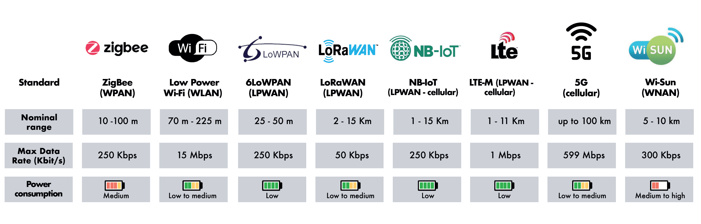
Communication Devices and technologies
Each communication technology has its own characteristics. To determine the type of communication device of objects, we must pay attention to these features.
Figure 4: characteristics of communication technologies and their impact on the power consumption

Slide 14
Power management
3

Slide 15
Power supplies in IoT
One of the first decisions in IoT system design should be the power source
The power source of smart things is determined by the area of application and The location which the node is placed
Urban and suburban areas
Power grid access
smart homes, wearable, agriculture, industry, etc.
In applications where nodes do not have access to the power grid, power management becomes very important and vital
[4] Internet of Things A to Z : Technologies and Applications

Slide 16
Power supplies in IoT
Power Sources for IoT
Storage
Distribution
Harvesting
Batteries
Micro-fuel cells
Micro-Heat engines
Super Capacitors
Power grid
Solar
Wind
Hydro
Mechanical
Thermal
Figure 5: Power Sources for IoT [5]

Slide 17
Power consumption
If the device will be powered by batteries then all design decisions must consider how to preserve power
Many networking technologies will not be a good fit with battery power.
Frequency of communication does have an influence on power selection.
[4] Internet of Things A to Z : Technologies and Applications

Slide 18
Battery capacity
battery capacity is how much energy is stored in the battery.
This power is often expressed in Watt-hours (the symbol Wh).
A Watt-hour is the voltage (V) that the battery provides multiplied by how much current (Amps) the battery can provide for some amount of time (generally in hours).
Voltage * Amps * hours = Wh.
www.learn.adafruit.com/all-about-batteries/power-capacity-and-power-capability

Slide 19
Battery capacity
voltage is pretty much fixed for a battery type due to its internal chemistry (alkaline, lithium, lead acid, etc)
For this reason, battery capacity is often represented by Amps*hour, expressed in Ah or mAh (1000mAh = 1Ah).
For example, lets say we have a 3V nominal battery with 1Amp-hour capacity, therefore it has 3 Wh of capacity. 1 Ah means that in theory we can draw 1 Amp of current for one hour, or 0.1A for 10 hours, or 0.01A (also known as 10 mA) for 100 hours.

Slide 20
Battery Capacity and Battery Capability
Battery Capability means the amount of current that the battery can deliver. It is also known as C-rating.
the amount of current we can really draw (the Battery capability) from a battery is often limited.
for example, a coin cell that is rated for 1 Ah can't actually provide 1 Amp of current for an hour, in fact it cant even provide 0.1 Amp without overextending itself (Its like saying a human has the capability to travel up to 30 KM: of course running 30 KM is a lot different than walking!)
Likewise, a 1Ah coin cell has no problem providing a 1mA for 1000 hours but if you try to draw 100mA from it, it'll last a lot less than 10 hours.
www.learn.adafruit.com/all-about-batteries/power-capacity-and-power-capability

Slide 21
Battery Capacity and Battery Capability
Example: 2500 mAh it means that the battery has a capability to deliver 2.5A/2500mA of current to the load for 1 hour. The time that the battery works continuously depends upon the load current that it consumes. So if the load consumes only 25 mA of current then the battery can stay alive for 100 hours.

Slide 22
Different kind of Batteries
Basically, all the electrochemical cells and batteries are classified into two types:
Primary (non-rechargeable)
Secondary (rechargeable)
Even though there are several other classifications within these two types of batteries, these two are the basic types. Simply speaking, Primary Batteries are non-rechargeable batteries i.e., they cannot be recharged electrically while the Secondary Batteries are rechargeable batteries i.e., they can be recharged electrically.
Different type of Batteries | electronicshub.org

Slide 23
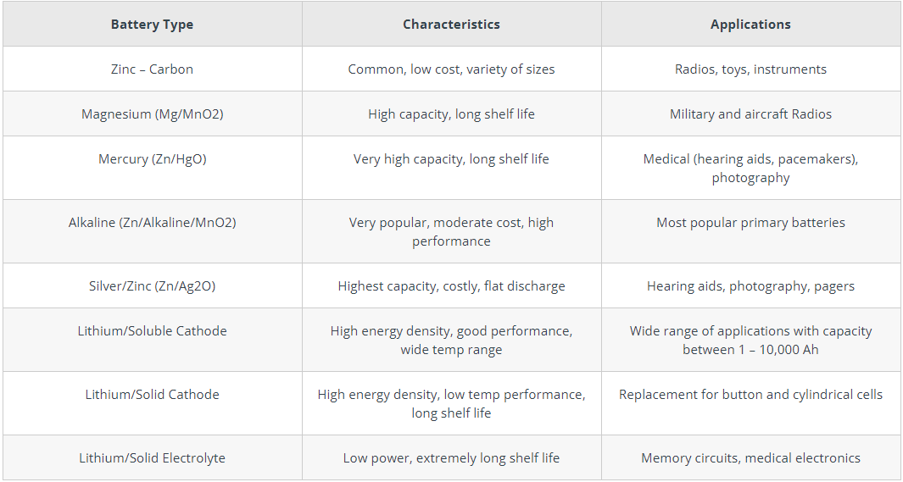
Different kind of Batteries
comparison of non-rechargeable Batteries
table 1: primary batteries | electronicshub

Slide 24
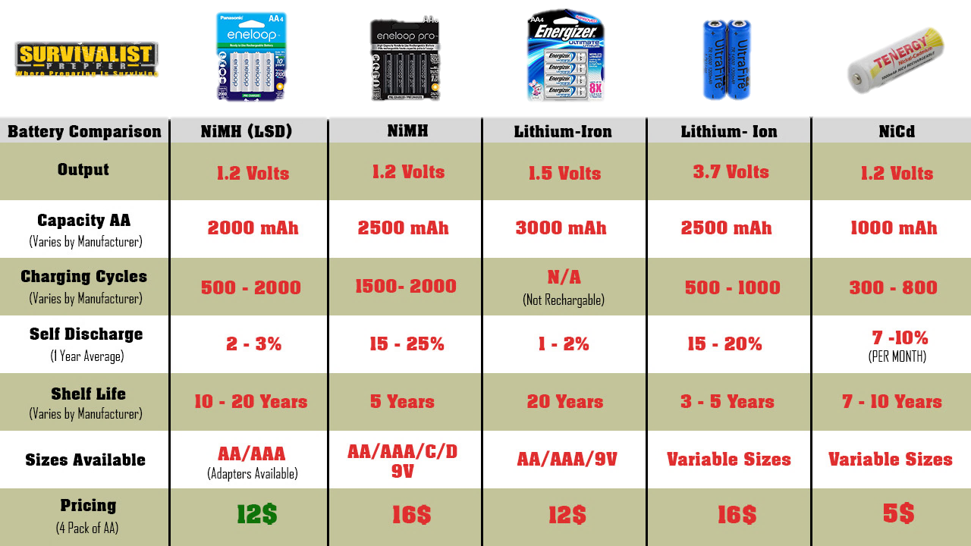
Different kind of Batteries
comparison of rechargeable Batteries
table2: secondary batteries

Slide 25
How to Choose a Battery?
Selecting a battery for your application can be dialed down to just two characteristics: Performance and Cost. But if we dig a little bit deeper, then the following are determining factors in choosing the right battery for your application.
Primary or Secondary
Energy or Power
Shelf Life
Energy Efficiency and Recharge Rate
Battery Life
Battery Temperature
cost
Different type of Batteries | electronicshub.org

Slide 26
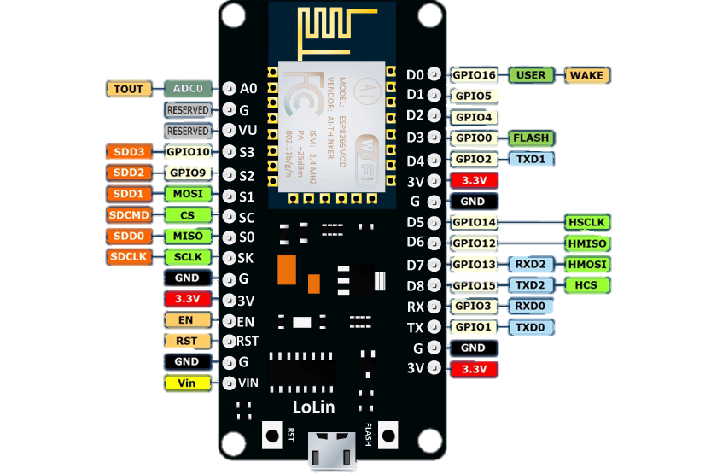
Connecting battery
For powering SoCs we need to connect battery to the Vin (voltage input) pin.
Important thig that we must consider is the board working voltage and on-board voltage regulator Specifications.
Figure 7: esp8266pinout [7]

Slide 27
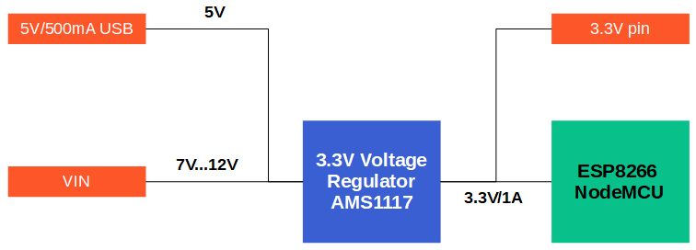
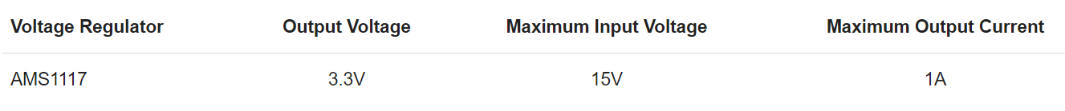
Connecting battery
The NodeMCU has a build in AMS1117 3.3V voltage regulator that transforms the input voltage from the 5V USB connection as well as the voltage of the VIN pin to the stable 3.3V output voltage.
Figure 8: esp8266 voltage levels
https://diyi0t.com/best-battery-for-esp8266/

Slide 28
Importance of power management
A Key requirement for IoT devices is the ability to consume very low power while maintaining an acceptable level of performance, which could enable them to run on batteries for long periods of time.
Depending on usage patterns and the power requirements of the attached sensors, actuators, or integrated circuits (ICs), a device may be put into sleep mode or into low-power mode periodically to conserve power.
[4] Internet of Things A to Z : Technologies and Applications

Slide 29
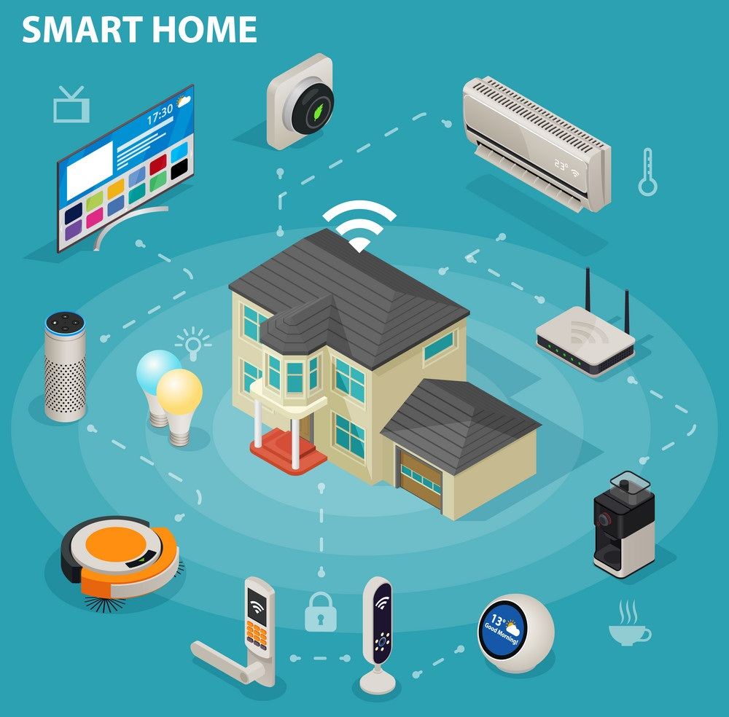
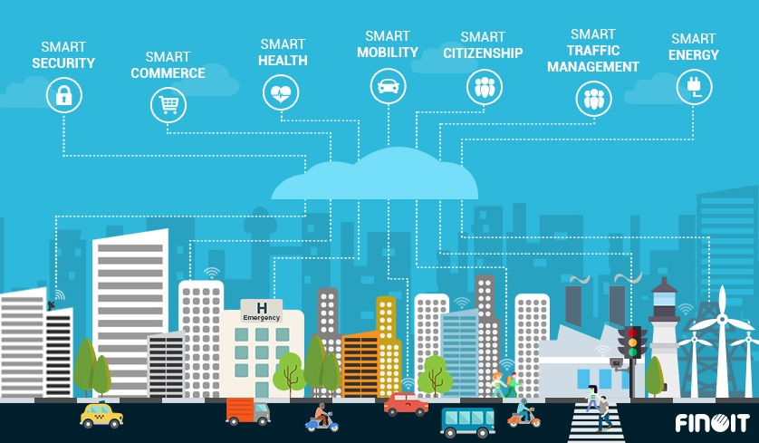
Importance of power management
In some applications power management is not very critical. For example smart home, some of smart city applications and etc.[8]
Why is that? Connecting to power grid
Figure 9: smart home
Figure 10: smart city

Slide 30
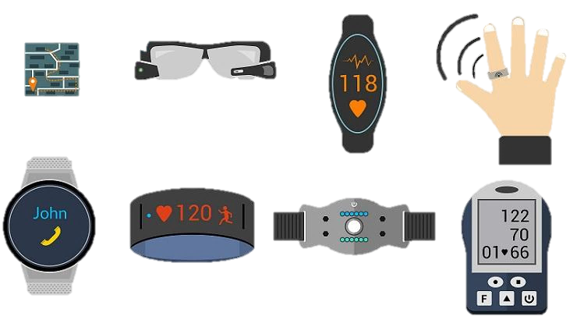
Importance of power management
Power management is a critical factor for portable and wearable IoT devices that rely on a wireless power source, such as batteries or photovoltaic cells (solar).
Figure 11: wearable devices

Slide 31

power management – example
Let's look at an example of the importance of power consumption management.
Suppose we want to make an agricultural land smart using the Internet of Things approaches.
This agricultural land has an area of ​​10 hectares
Figure 12: smart agriculture

Slide 32
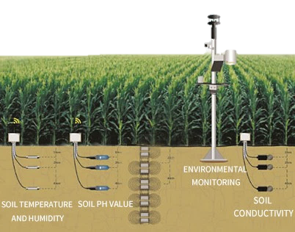
power management – example
We need to collect important data from all over the farm Using the nodes we designed
What if we do not consider power management in nodes?
Overhead become more than profit
What can we do?
Does the node need to be always on?
Duty-cycle
Frequency of data transmission
Other examples?
Figure 13: collecting data in farm land

Slide 33
Importance of power management
So we need to consider power consumption management in designing smart things.
There are two important categories for power management:
Software technics (section 4)
Hardware approaches (section 5)

Slide 34
software technics to reduce power consumption
4

Slide 35
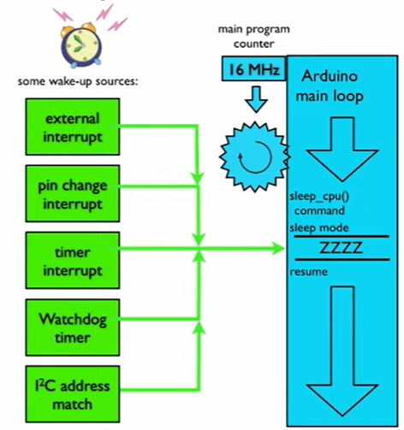
Sleep mode process
The Arduino main loop typically runs continuously
By using sleep modes we can pause execution of the loop
Number of wake-up sources can be use to wake the Arduino up and resume the program execution
Once in sleep mode the ATmega328p can be woken up via an external signal or internal time-based events
[9] ATMega328P Datasheet
Figure 14: sleep process | makecourse

Slide 36
Wake-up events
There are two general types of wake-up events
External interrupts (using external signals)
Internal interrupts (using internal time-based events)
[9] ATMega328P Datasheet

Slide 37
Interrupts
What is an Interrupt?
Interrupts are the events that temporarily suspend the main program, pass the control to the external sources and execute their task. It then passes the control to the main program where it had left off.
Main program
Interrupt service routine (ISR)
Command 1
Command 1
Command 2
Command 2
Command 3
interrupt
Command 4
Command 5
[10] Embedded Systems: Introduction to ARM®CORTEX-M Microcontrollers

Slide 38
External Interrupts
External Interrupts
External interrupts triggered by a state change on one of the digital pins
Trigging Interrupts
An interrupt can be triggered when a digital pin goes from low to high or from high to low (rising and falling edge)
High
Low
[10] Embedded Systems: Introduction to ARM®CORTEX-M Microcontrollers

Slide 39
External Interrupts
External Interrupts pins
Board | INT0 | INT1 | INT2 | INT3 | INT4 | INT5 | … | INT15
UNO | pin2 | pin3
Nano | pin2 | pin3
Pro mini | pin2 | pin3
Mega | pin2 | pin3 | pin21 | pin20 | pin19 | pin18
esp8266 | GPIO 0 | GPIO 1 | GPIO 2 | GPIO 3 | GPIO 4 | GPIO 5 | ... | GPIO 15
Table3: interrupt pins of Arduino and esp8266 boards [6][9]

Slide 40
External Interrupts
How to use External Interrupts in Arduino
attachinterrupt(0 , buttonPressed , RISING)
0 -> INT 0 = pin 2
buttonPressed -> ISR name (name of th function to run after interrupt)
RISING -> Trigger mode
RISING trigger mode
FALLING trigger mode
High
Low
interrupt
interrupt
[9] ATMega328P Datasheet

Slide 41
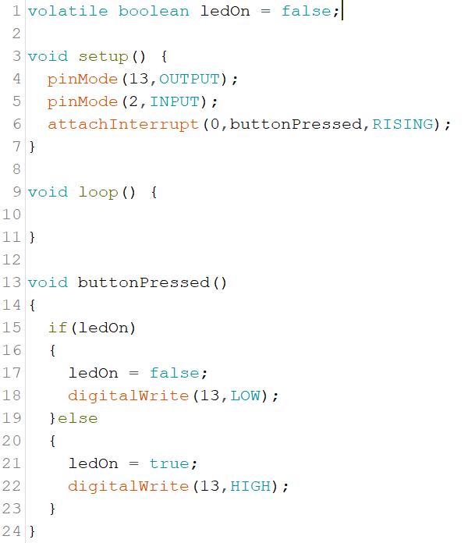
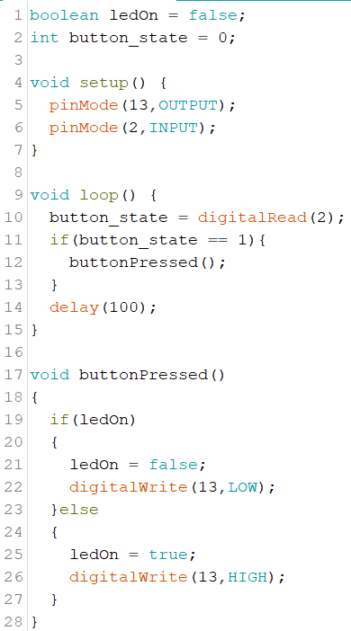
External Interrupts
Changing LED state with and without external interrupt.
Figure 15: changing LED state using external interrupt
Figure 16: changing LED state without external interrupt
[9] ATMega328P Datasheet

Slide 42
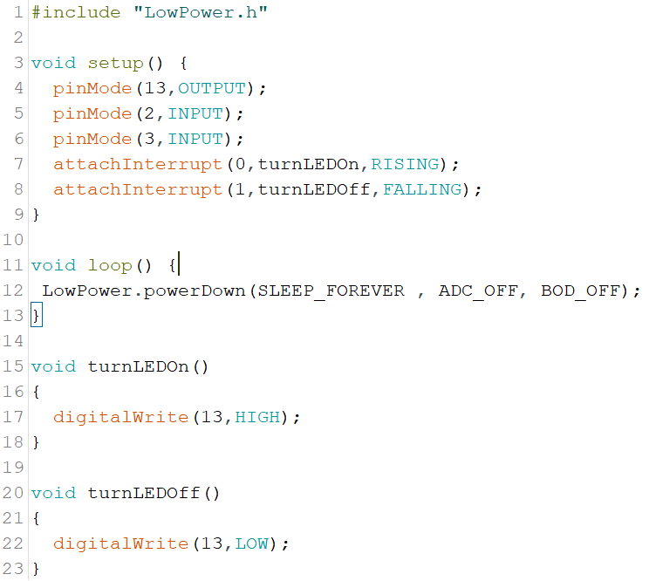
External Interrupts
Any sensor that produces digital output can be used as an external interrupt maker.
Motion detector, smoke detector, humidity and water level sensors and etc.
movement
High
Low
10 sec
INT 0
INT 1
Figure 17: changing LED state using motion detector external interrupt

Slide 43
Internal Interrupts
Internal Interrupts are time-based events. They are managed using clock and timers of the system.
We use periodic timers to create internal interrupts
For example:
lowPower.powerDown(SLEEP_8S, ADC_OF, BOD_OF)
Sleep_8s means that the Arduino board wakes up after 8 seconds due to an internal interrupt..
[9] ATMega328P Datasheet

Slide 44
Sleep modes
Arduino boards have 6 different sleep modes:
Idle the least power saving
ADC noise reduction
Power save
Extended standby
Standby
Power down the most power saving
[9] ATMega328P Datasheet

Slide 45
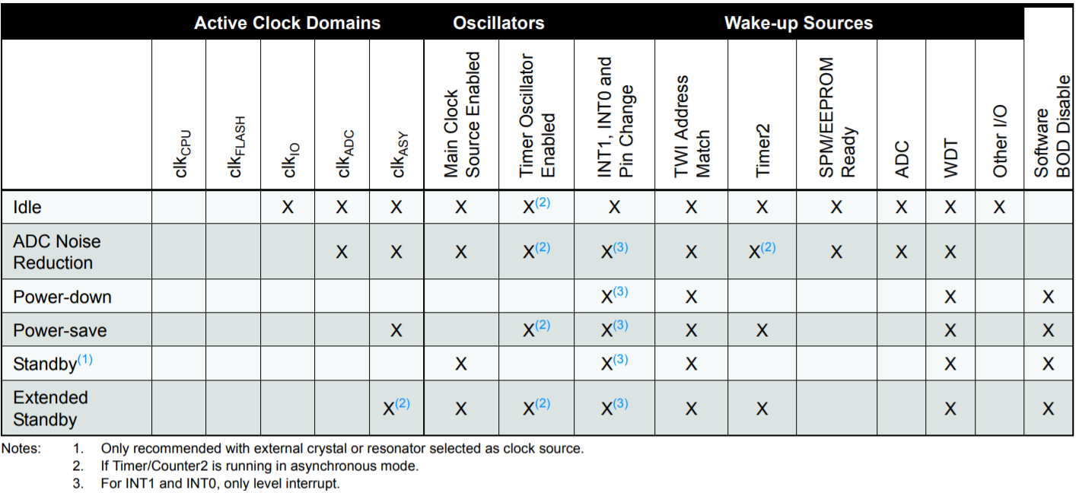
Sleep modes
Table4: Active Clock Domains and Wake-up Sources in the Different Sleep Modes [9]

Slide 46
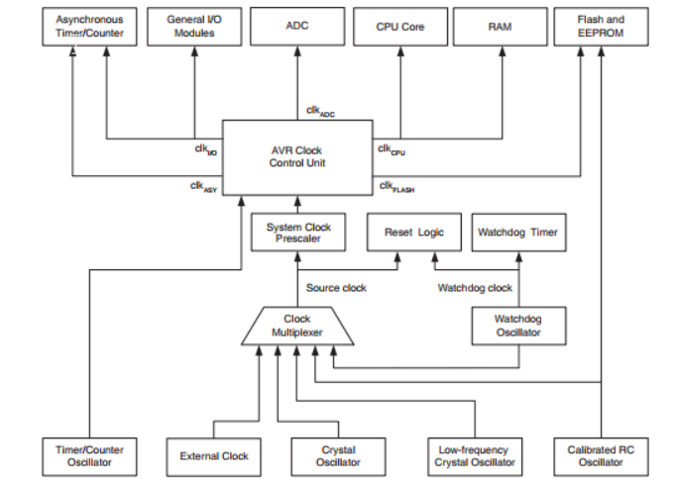
Atmega328p system clock
Figure 18: Atmega328p clock distribution System | arnabkumardas.com

Slide 47
Sleep mode libraries
There is two library to manage sleep modes in Arduino
<avr/sleep.h> AVR
<lowPower.h> rocket scream github

Slide 48
Power-down sleep mode
Using lowPower library
LowPower.powerDown(period, adc, bod);
Period -> Duration of low power mode.
adc -> ADC module disable control.
ADC_OFF - Turn off ADC module
ADC_OFF - Leave ADC module in its default state
Bod -> Brown Out Detector (BOD) module disable control
BOD_OFF - Turn off BOD module
BOD_ON - Leave BOD module in its default state
Low power library | github

Slide 49
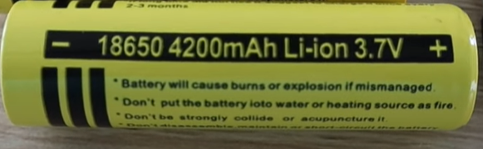
Power-down sleep mode
Lets see the effect of powerDown sleep mode on power consumption.
We are going to test the power consumption of 6 different Arduino boards(nano, uno, mega, pro macro, 5 volt pro mini, 3.3 pro mini) using the same battery
Figure 19: 4200mAh Li-ion battery

Slide 50
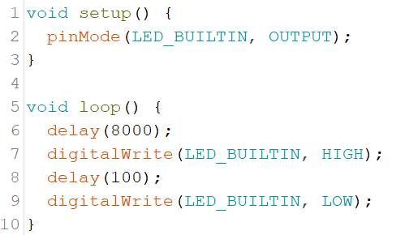
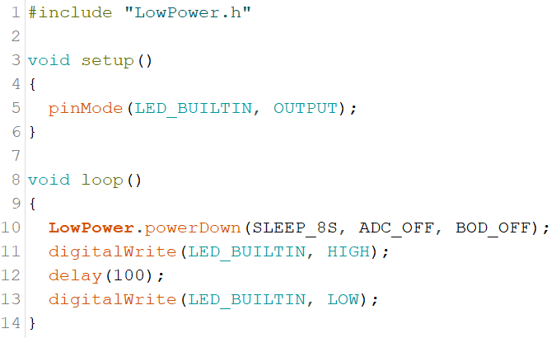
Power-down sleep mode
Lets test battery life of Arduino boards in normal and low power mode
Figure 20: normal code
Figure 21: low power code
Comparison of normal and low power mode in Arduino | YouTube

Slide 51
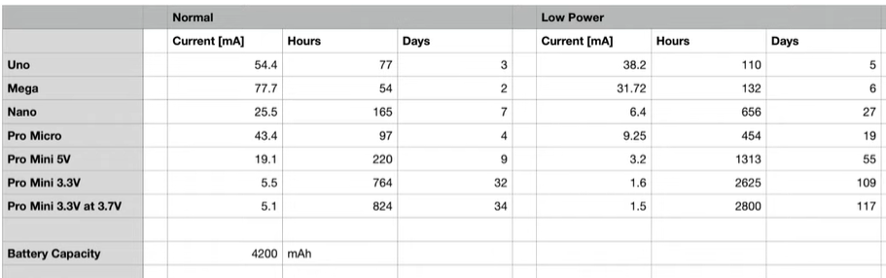
Power-down sleep mode
Figure 22: comparison of Arduino boards in normal and low power mode | YouTube

Slide 52
ESP8266
ESP8266EX is designed with advanced power management technologies and intended for mobile devices, wearable electronics and the Internet of Things applications.[6]
The low-power architecture operates in the following modes:
Active mode: Wi-Fi is powered on. It can receive, transmit, or listen.
Modem-sleep mode: The CPU is operational. The Wi-Fi is disabled.
Light-sleep mode: The CPU and all peripherals are paused. Any wake-up events (MAC, host, RTC timer, or external interrupts) will wake up the chip.
Deep-sleep mode: Only the RTC is operational and all other part of the chip are powered off.
[6] esp8266ex Datasheet

Slide 53
ESP8266
ESP8266 series chip provides 3 configurable sleep modes. Users can choose and configure the sleep mode as required.[6]
Table 1 shows the differences between the 3 sleep modes.
RTC (Real-Time Clock).
DTIM (Delivery Traffic Indication Message).
Deep-sleep mode is controlled by users. Users can call the function to enable Deep-sleep instantly. For details, please refer to Section 4. Deep-sleep.

Slide 54
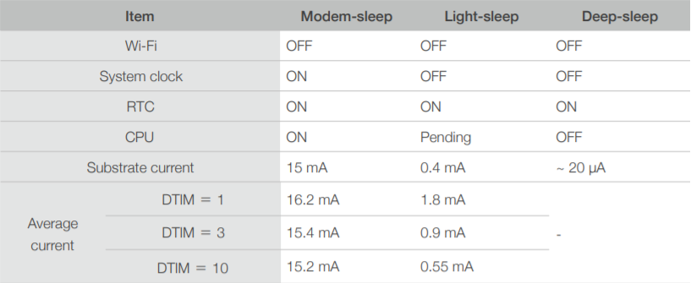
ESP8266
Table 5: comparison of sleep modes in ESP8266 [6]

Slide 55
ESP8266 – Modem-Sleep
Modem-sleep mode is enabled only when ESP8266 connects to the router in station mode. ESP8266 stays connected to the router through the DTIM beacon mechanism.
The DTIM beacon interval of the router is usually 100ms to 1000ms
In Modem-sleep mode, ESP8266 will close the Wi-Fi module circuit between the two DTIM Beacon intervals in order to save power.
ESP8266 will be automatically woken up before the next Beacon arrival. The sleep time is decided by the DTIM Beacon interval time of the router
During sleep, ESP8266 can stay connected to the Wi-Fi and receive the interactive information from a mobile phone or server.
[6] esp8266ex Datasheet

Slide 56
ESP8266 Modem-Sleep
Interface:
Modem-sleep: The system goes into Modem-sleep via the following interface
wifi_set_sleep_type(MODEM_SLEEP_T)
In Modem-sleep, the system can be woken up automatically. Users don’t need to configure the interface.
Application: Modem-sleep is generally used in the applications that need the CPU powered on. An example of the applications is Pulse Width Modulation (PWM) light that needs real-time CPU control.
[6] esp8266ex Datasheet

Slide 57
ESP8266 Light-Sleep
The working mode of Light-sleep is similar to that of Modem-sleep. The difference is that, during Light-sleep mode, except from Wi-Fi circuit, ESP8266 also powers off clock and suspends internal CPU, resulting in less power than in Modem-sleep mode.
Interface:
Light-sleep: The system goes into Light-sleep via the following interface
wifi_set_sleep_type(LIGHT_SLEEP_T)
ESP8266 automatically enters Light-sleep mode when connected to Wi-Fi with the CPU idle.
[6] esp8266ex Datasheet

Slide 58
ESP8266 Light-Sleep
External Wake-up :
During Light-sleep, the CPU is suspended and will not respond to the signals and interrupts from the peripheral hardware interfaces. Therefore, ESP8266 needs to be woken up via external GPIO. The waking process is less than 3 ms The GPIO wake-up function can only be enabled by level triggers. The interface is as follows.
void gpio_pin_wakeup_enable(uint32 i, GPIO_INT_TYPE intr_state);
GPIO16 cannot be used for wake-ups.
Uint32 i | The IO serial number of the wake-up function
GPIO_INT_TYPE Intr_state | The trigger mode of wake-up GPIO_PIN_INTR_LOLEVEL GPIO_PIN_INTR_HILEVEL
Table6: external wake-up function inputs[6]

Slide 59
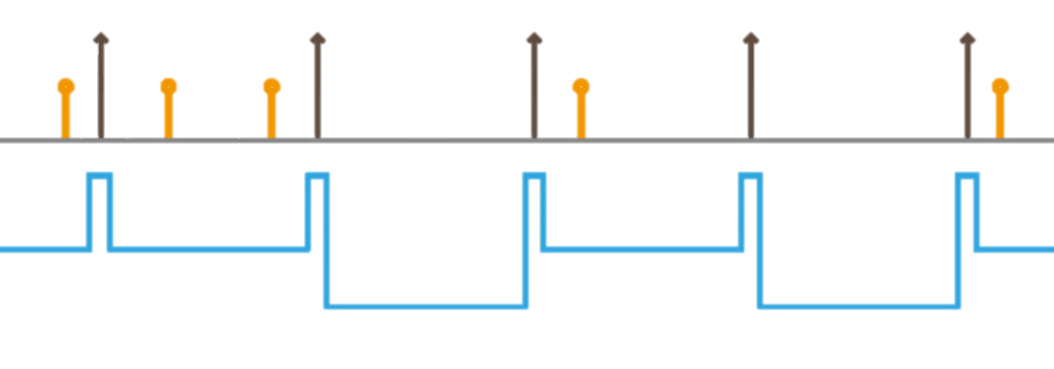
ESP8266 Light-Sleep
Application: Light-sleep mode can be used in the scenarios where the applications need to stay connected to the router and can respond to the sending data from the router in real time. The CPU can be idle before receiving commands. An example is the Wi-Fi switch whose CPU is idle for most of the time and only performs GPIO operations until receiving the control commands.[7]
Note: If a task interval is shorter than the DTIM beacon interval, the system cannot go into Light-sleep mode, as the figure below shows
TIM
TIM
TIM
TIM
TIM
timer
timer
timer
timer
timer
Mode-sleep
Mode-sleep
Light_sleep
Light_sleep
Figure 23: DTIM beacon intervals [8]

Slide 60
ESP8266 Deep-Sleep
Unlike the other two modes, the system cannot go into Deep-sleep automatically
Users can call the interface function system_deep_sleep to immediately enable Deep-sleep.
In this mode, the chip will turn off Wi-Fi connectivity and data connection; only the RTC module is still working, responsible for periodic wake-ups.
[8] esp8266ex Datasheet

Slide 61
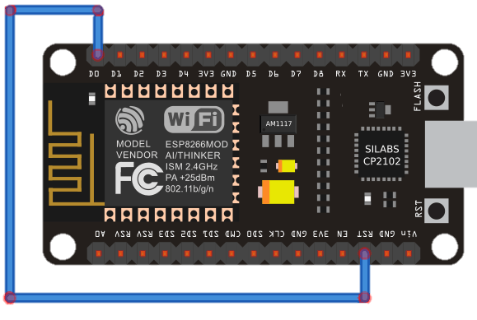
ESP8266 Deep-Sleep
Interface:
Enable Deep-sleep: The system goes into Deep-sleep mode via the following interface
void system_deep_sleep(uint32 time_in_us)
To enable Deep-sleep, you need to connect GPIO16 to the EXT_RSTB pin of ESP8266
Figure 24: connecting GPIO16 to RST pin | randomnerdtutorials.com
[7] esp8266ex Datasheet

Slide 62
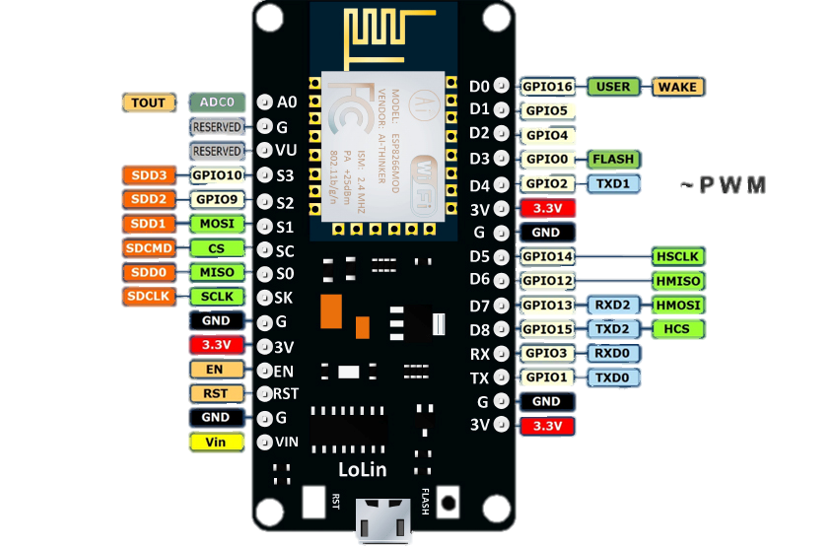
ESP8266 Deep-Sleep
Why connect GPIO16 to RST pin?
Especial wake pin
RESET pin HIGH → ESP running
RESET pin LOW → ESP restarts
Figure 25: esp8266pinout [7]
Configure Deep-sleep [7]

Slide 63
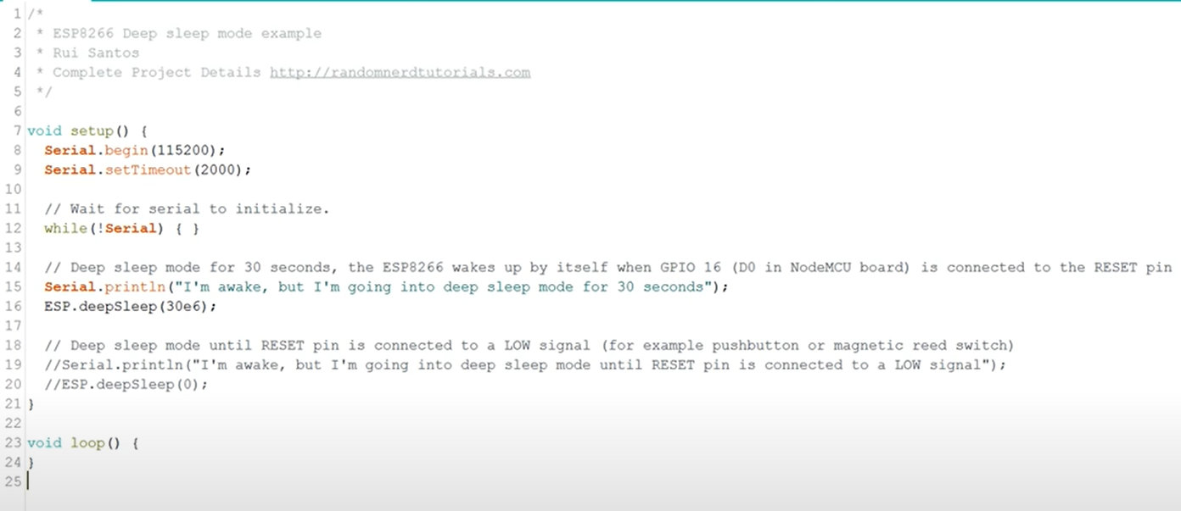
ESP8266 Deep-Sleep
Figure 26: deep sleep mode | randomnerdtutorials.com

Slide 64
ESP8266 Deep-Sleep
Application: Deep-sleep can be used in low-power sensor applications or in the scenarios where data transmission is not required for most of the time. The device wakes up from Deep-sleep at intervals to measure and upload data, and then goes to Deep-sleep again. The device can also store data in the RTC memory (which can still save data in Deep-sleep mode) and then send it at a time.[7]

Slide 65
Hardware approaches to manage power consumption
5

Slide 66
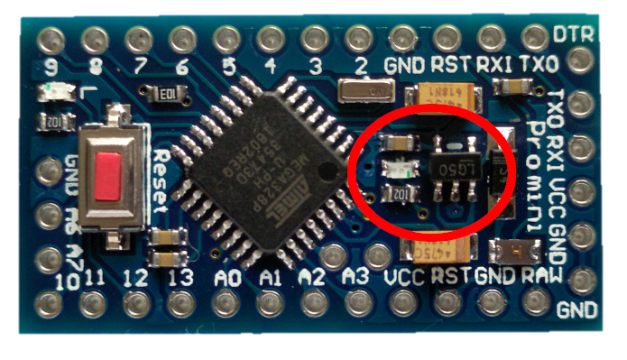
Removing extra parts
Every small change has a big impact
Lets start with a simple test
Removing power LED from Arduino pro mini
Power led
Figure 27: Arduino pro mini

Slide 67
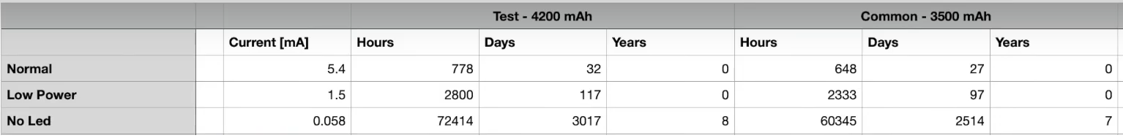
Removing extra parts
Table below show the current draw of a Arduino pro mini with and without power LED
Table 7: comparison of power consumption in Arduino pro mini | YouTube

Slide 68
Using required peripherals
As we saw in the last example, it is very important to use only required and necessary peripherals, no more and no less
We have to design the hardware according to this principle to reduce power consumption in nodes.
Microcontroller development boards are PCBs with additional circuitry to support the microcontroller to make it more convenient to prototype with and program the chip
SoC and SBC are good as prototypes but not usually ideal for real product
https://developer.ibm.com/articles/iot-lp101-best-hardware-devices-iot-project/

Slide 69
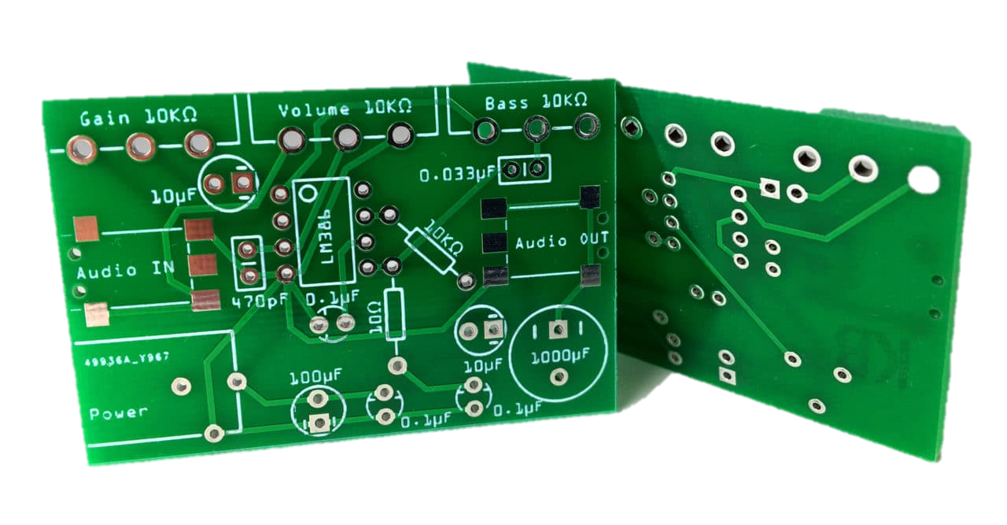
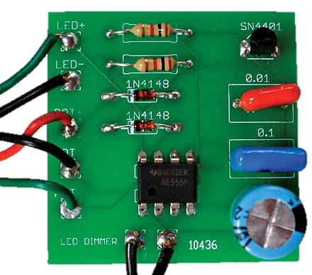
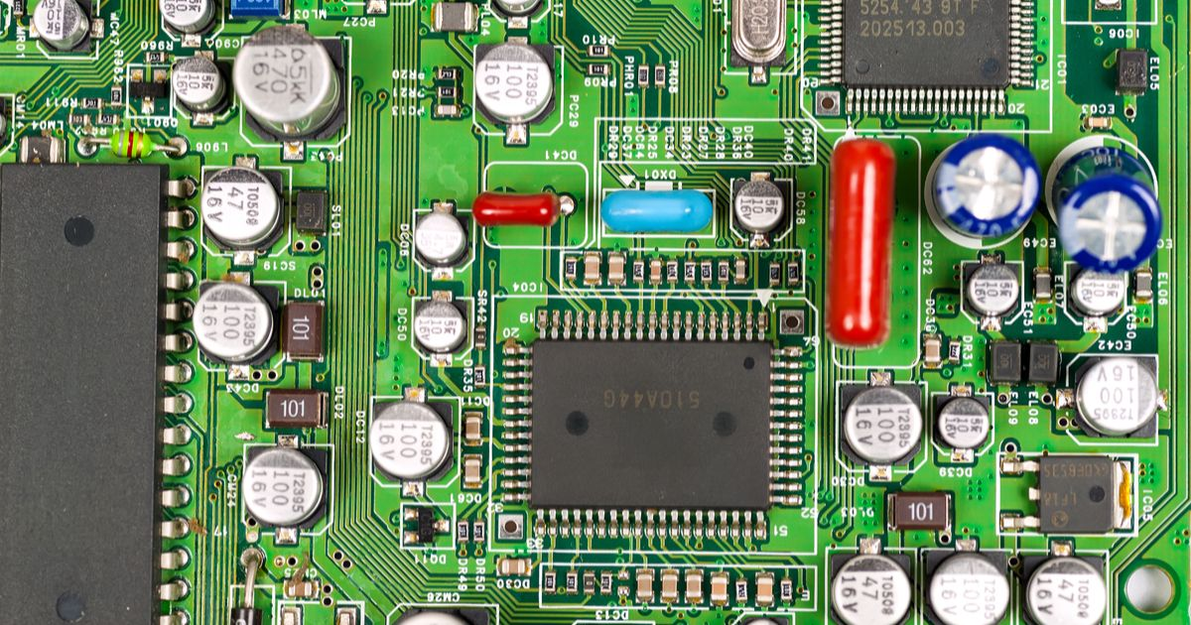
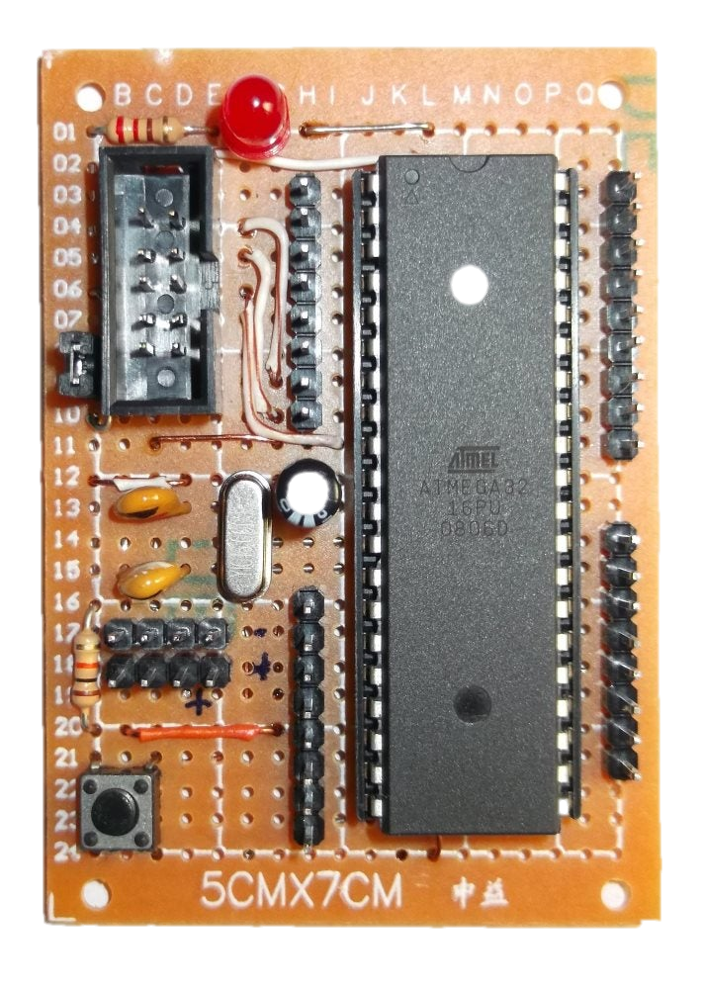
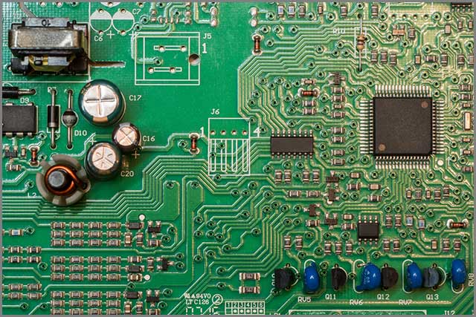
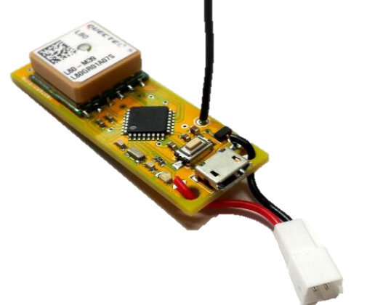
PCB design
Figure 28: PCBs

Slide 70
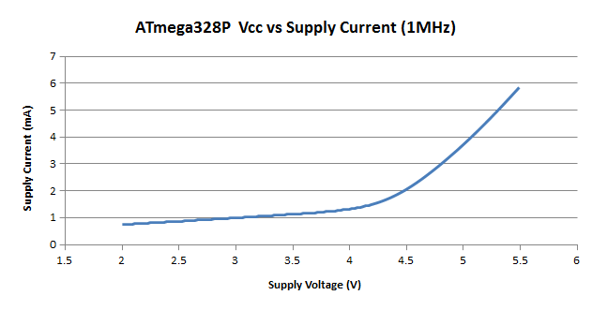
Lowering the Voltage
One of the easiest ways to reduce current is to lower the voltage you give to the board.[12]
Figure 29: impact of working voltage on current draw [12]
[12] A SURVEY ABOUT POWER CONSUMPTION FOR ARDUINO

Slide 71
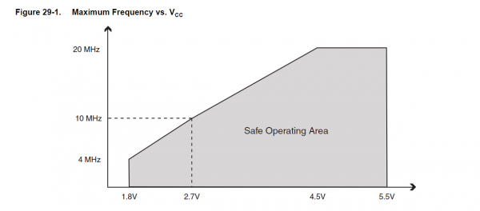
Lowering the Voltage
Reducing the voltage, does have a catch though. Reducing the system voltage too much, without reducing clock speed, could make the microcontroller start to behave strangely. In Arduino boards The Mega, Uno, nano, and 5V Pro Mini all use a 16MHz crystal but 3.3V pro mini use a 8MHz crystal.
The relationship between clock speed and system voltage is the reason our 3.3V Pro Mini uses a 8MHz clock instead of 16MHz.
Figure 30: clock speed and voltage [12]
[12] A SURVEY ABOUT POWER CONSUMPTION FOR ARDUINO

Slide 72
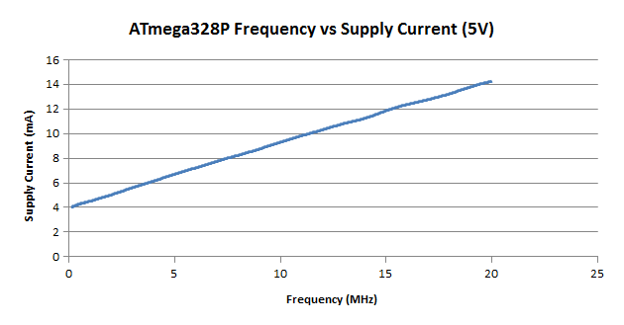
Reducing the Clock Speed
In projects where doesn't need to execute a large number of instructions in a short amount of time or in projects where timing isn't an issue, reducing the clock speed of the microcontroller can shave a few milliamps off the supply current.[12]
Figure 31: impact of frequency on current draw [12]
[12] A SURVEY ABOUT POWER CONSUMPTION FOR ARDUINO

Slide 73
Important pins
6
ADC, PWM

Slide 74
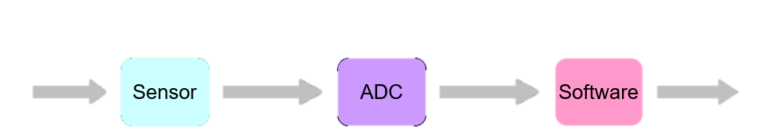
Analog to Digital converter (ADC)
Everything in the physical world is an analog signal
Sound, light, temperature, pressure
Need to convert into digital signals
Physical
phenomena
Voltage or
current
ADC counts
Engineering
units
Figure 32: ADC [12]
[13] EECS 373 Design of Microprocessor-Based Systems

Slide 75
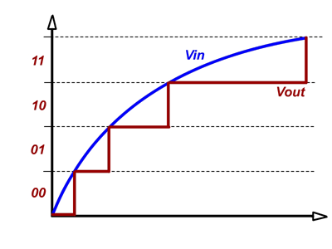
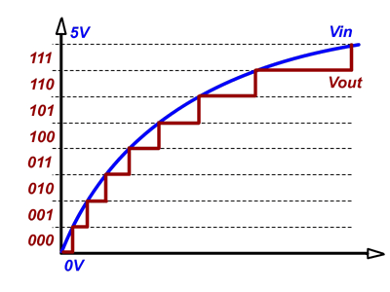
Analog to Digital converter (ADC)
resolution
Figure 35: different resolutions

Slide 76
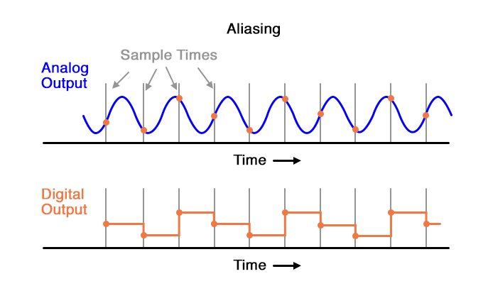
Analog to Digital converter (ADC)
Sampling time, nyquist theorem
Figure 34: sample time

Slide 77
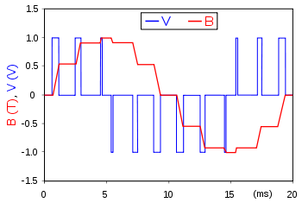
pulse width modulation (PWM)
PWM is a way to control analog devices with a digital output
Drive analog devices like variable-speed motors, dimmable lights, actuators, and speakers
PWM is not true analog output
PWM “fakes” an analog-like result by applying power in pulses, or short bursts of regulated voltage
Figure 30: pwm
https://www.analogictips.com/pulse-width-modulation-pwm/

Slide 78
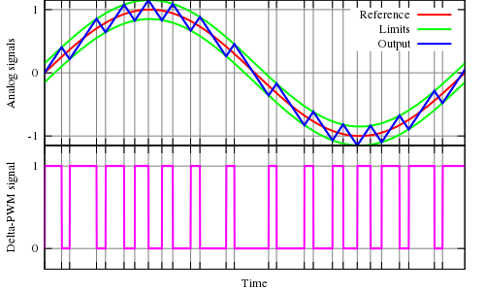
pulse width modulation (PWM)
Figure 36: https://commons.wikimedia.org/wiki/File:Delta_PWM.svg

Slide 79
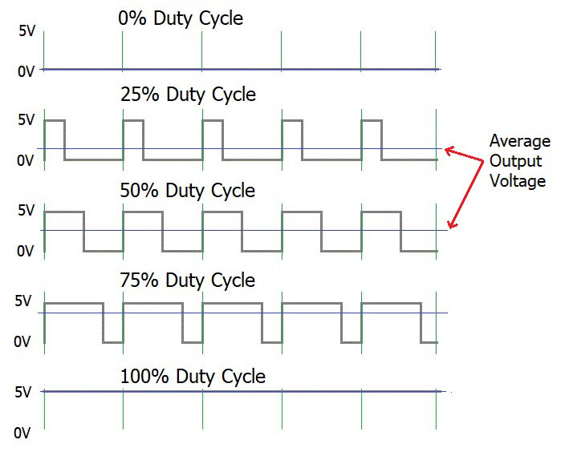
pulse width modulation (PWM)
Duty cycle
Figure 37: duty cycle

Slide 80
Reference
[1] Peter J. Ryan 1 and Richard B. Watson, “Research Challenges for the Internet of Things: What Role Can OR Play?” , systems journal, 14 March 2017.
[2] IoT Fundamentals: Networking Technologies, Protocols, and Use Cases for the Internet of Thing, Cisco press, 2017
[3] LPWAN white paper, Leverege LLC, 2020 | www.leverege.com
[4] Internet of Things A to Z : Technologies and Applications, IEEE Press, 2018
[5] P.P.Ray, A survey on Internet of Things architectures, Journal of King Saud University - Computer and Information Sciences, Volume 30, Issue 3, July 2018, Pages 291-319.
[6] Abhi Raj and Dan Steingart, “Review—Power Sources for the Internet of Things”, Electrochemical Society Journal, 25 April 2018.

Slide 81
Reference
[7] esp8266ex Datasheet
[8] 9B-esp8266-low_power_solutions
[9] Ricardo Reis, “Strategies for Reducing Power Consumption and Increasing Reliability in IoT”, IFIP International Internet of Things Conference, 2018 - Springer
[10] ATMega328P Dataheet
[11] Embedded Systems:Introduction to ARM®CORTEX-M Microcontrollers, Vol. 1, 5th Ed., Jonathan W. Valvano, 2014
[12] Sabou sebastian, “A SURVEY ABOUT POWER CONSUMPTION FOR ARDUINO”
Carpathian Journal of Electrical Engineering, 2020
[13] EECS 373 Design of Microprocessor-Based Systems

Slide 82
THANKS!
You can find me at:
Email: hrhhemati@gmail.com
Telegram: @Hamidrezahematii

